Slide 2
1. Introduction to Distributed Systems Architecture
Definition: Architecture refers to the structure of components and their interrelationships, ensuring reliability, manageability, adaptability, and cost-effectiveness.
Analogy: Similar to building architecture (e.g., gothic, modern), it provides a consistent framework for design and scalability.

Slide 3
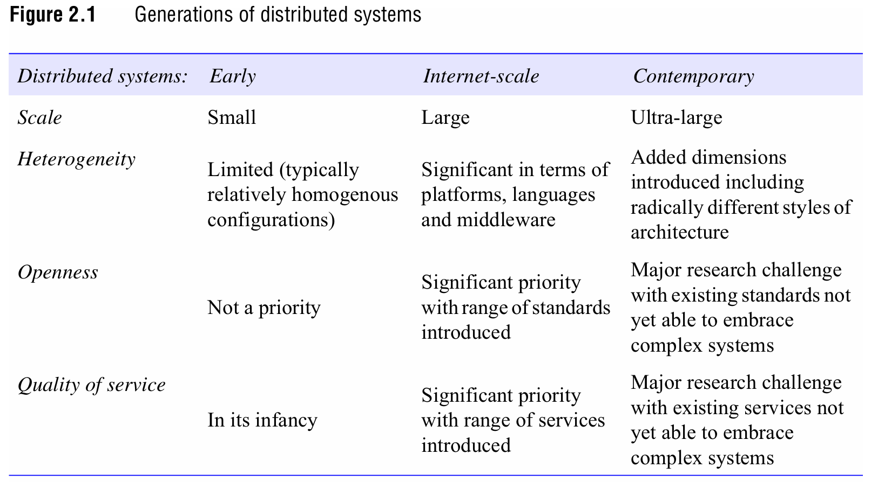

Slide 4
2. Core Architectural Elements
Communicating Entities
  Processes/Threads: Fundamental units in most systems, with threads as communication endpoints.
  Problem-Oriented Abstractions:
    Objects: Encapsulate behavior, accessed via interfaces (e.g., CORBA, Java RMI).
    Components: Explicit dependencies and contracts for system composition (e.g., EJB, .NET).
    Web Services: Web-integrated, XML-based services for cross-organizational integration (e.g., SOAP, REST).

Slide 5
2. Core Architectural Elements
Communication Paradigms
Interprocess Communication (IPC): Low-level message passing (e.g., sockets, multicast).
Remote Invocation:
  Request-Reply: Simple client-server exchanges (e.g., HTTP).
  RPC/RMI: Abstract distribution for procedure/method calls (e.g., Java RMI).
Indirect Communication:
  Publish-Subscribe: Decoupled event routing (e.g., Apache Kafka).
  Message Queues: Point-to-point via intermediaries (e.g., RabbitMQ).
  Tuple Spaces: Persistent data sharing (e.g., Linda).

Slide 6
2. Core Architectural Elements
Roles and Responsibilities
Client-Server: Centralized roles with clients requesting services from servers (scalability challenges).
Peer-to-Peer (P2P): Decentralized, cooperative roles (e.g., BitTorrent, blockchain).

Slide 7
2. Core Architectural Elements
Placement Strategies
Multiple Servers: Partitioned or replicated data (e.g., web servers, DNS).
Caching: Proximity storage (e.g., browser caches, CDNs).
Mobile Code/Agents: Code execution at client-side (e.g., JavaScript, mobile agents for fault tolerance).

Slide 8
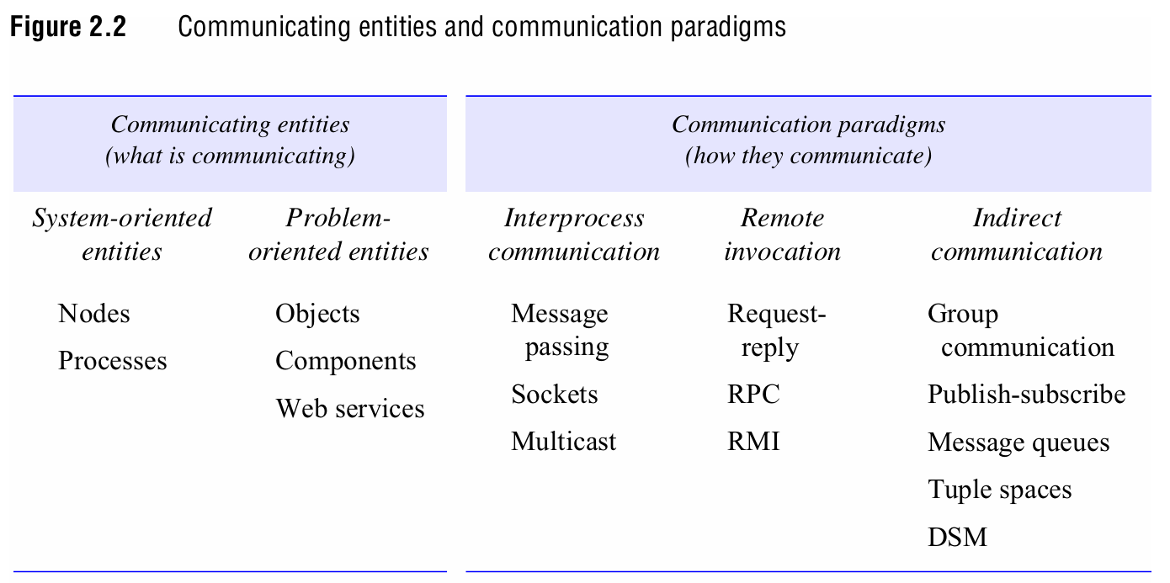

Slide 9
3. Architectural Patterns
Layering:
  Platform: Hardware/OS layers.
  Middleware: Masks heterogeneity (e.g., CORBA, gRPC).
Tiered Architectures:
  Two-Tier: Client-server split (e.g., desktop apps with local logic).
  Three-Tier: Presentation, application, data layers (e.g., web apps with separate DB servers).

Slide 10
3. Architectural Patterns
AJAX: Asynchronous client-server interaction for dynamic web apps (e.g., Google Maps).
Thin Clients: Minimal local processing, reliant on remote services (e.g., VNC, cloud terminals).
Other Patterns:
  Proxy: Local representation of remote objects (e.g., RMI stubs).
  Broker: Mediates service discovery (e.g., SOA registries).
  Reflection: Dynamic introspection/modification (e.g., adaptive middleware).

Slide 11
4. Middleware Solutions
Categories:
  Distributed Objects: CORBA, Java RMI.
  Components: Enterprise JavaBeans (EJB).
  Publish-Subscribe: Apache Kafka.
  Message Queues: RabbitMQ.
  Web Services: REST APIs, SOAP.
  Peer-to-Peer: Bitcoin, BitTorrent.
Limitations:
  End-to-End Argument: Certain functions (e.g., security, fault recovery) must be implemented at the application level, not solely in middleware.

Slide 12
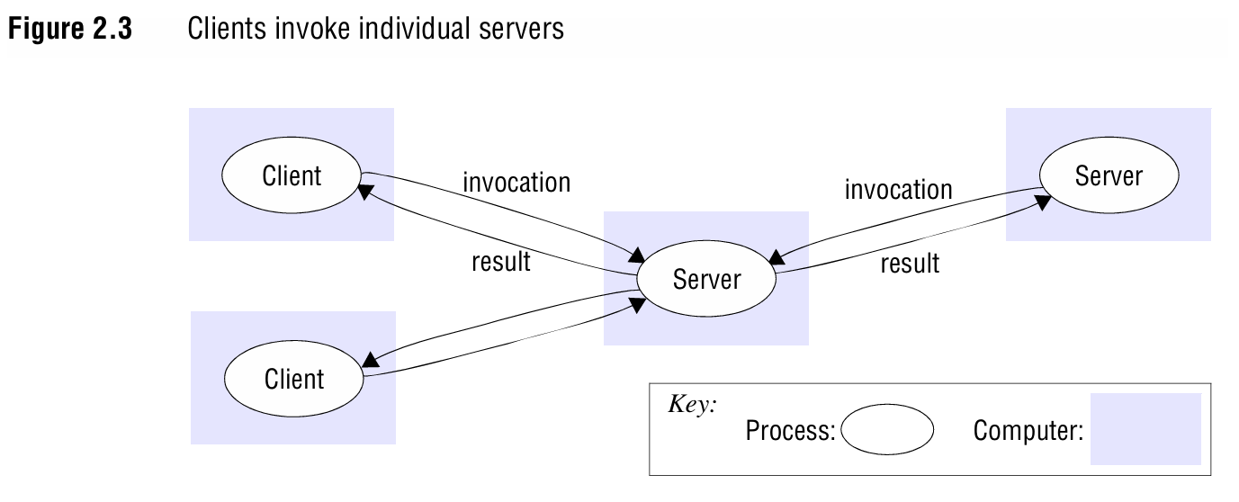

Slide 13
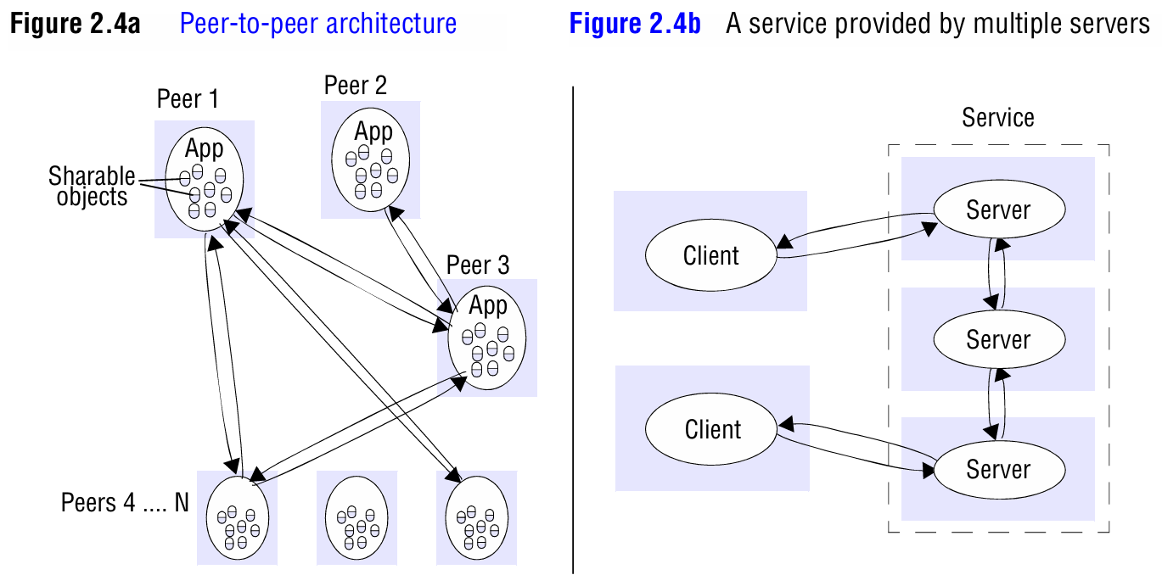

Slide 14
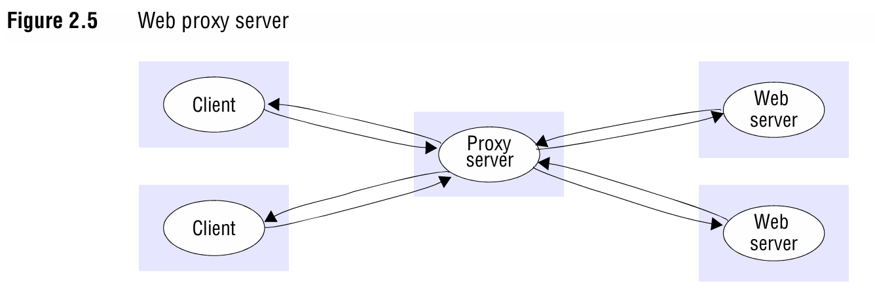

Slide 15
5. Key Considerations
Trade-offs: Performance vs. transparency, centralization vs. decentralization.
Design Focus: Balancing core elements, patterns, and middleware while addressing scalability, latency, and reliability.

